Slide 1
8
Disk Storage, Basic File Structures, and Hashing

Slide 2
8.2 - Buffering

Slide 3
System Design Goals
Allow the DBMS to manage databases that exceed the amount of memory available.
Reading/writing to disk is expensive, so it must be managed carefully to avoid large stalls and performance degradation.
Why Not Use The OS?

Slide 4
Why Not Use The OS?
DBMS (almost) always wants to control things itself and can do a better job at it.
→ Flushing dirty pages to disk in the correct order.
→ Specialized prefetching.
→ Buffer replacement policy.
→ Thread/process scheduling.
The OS is not your friend.

Slide 5
Database Storage
Spatial Control:
→ Where to write pages on disk.
→ The goal is to keep pages that are used together often as physically close together as possible on disk.
Temporal Control:
→ When to read pages into memory, and when to write
them to disk.
→ The goal is minimize the number of stalls from having to read data from disk.

Slide 6
DATABASE PAGES
There are three different notions of "pages" in a DBMS:
→ Hardware Page (usually 4KB)
→ OS Page (usually 4KB)
→ Database Page (512B-16KB)
A hardware page is the largest block of data that the storage device can guarantee failsafe writes.

Slide 7








DATABASE PAGES
4KB
There are three different notions of "pages" in a DBMS:
→ Hardware Page (usually 4KB)
→ OS Page (usually 4KB)
→ Database Page (512B-16KB)
8KB
A hardware page is the largest block of data that the storage device can guarantee failsafe writes.
16KB

Slide 8
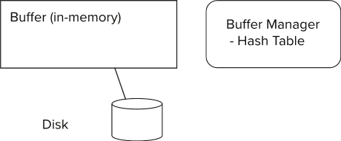
Storage Access
Blocks are units of both storage allocation and data transfer.
Database system seeks to minimize the number of block transfers between the disk and memory. We can reduce the number of disk accesses by keeping as many blocks as possible in main memory.
Buffer – portion of main memory available to store copies of disk blocks.
Buffer manager – subsystem responsible for allocating buffer space in main memory.
Notes:
8

Slide 9
Buffer Manager
Programs call on the buffer manager when they need a block from disk.
If the block is already in the buffer, buffer manager returns the address of the block in main memory
If the block is not in the buffer, the buffer manager
Allocates space in the buffer for the block
Replacing (throwing out) some other block, if required, to make space for the new block.
Replaced block written back to disk only if it was modified since the most recent time that it was written to/fetched from the disk.
Reads the block from the disk to the buffer, and returns the address of the block in main memory to requester.
Notes:
9

Slide 10
Buffer Manager
Buffer replacement strategy
Pinned block: memory block that is not allowed to be written back to disk
Pin done before reading/writing data from a block
Unpin done when read /write is complete
Multiple concurrent pin/unpin operations possible
Keep a pin count, buffer block can be evicted only if pin count = 0
Shared and exclusive locks on buffer
Needed to prevent concurrent operations from reading page contents as they are moved/reorganized, and to ensure only one move/reorganize at a time
Readers get shared lock, updates to a block require exclusive lock
Locking rules:
Only one process can get exclusive lock at a time
Shared lock cannot be concurrently with exclusive lock
Multiple processes may be given shared lock concurrently

Slide 11
Buffer Pools
Get page # 2
Execution
Engine
Directory
Header
Buffer Pool
Interpret the layout of page 2
2
Pointer to page #2
Memory
Directory
Database File
Header
Header
Header
Header
Header
…
1
2
3
4
5
Pages
Disk

Slide 12
Buffer Pool Organization
Memory region organized as an array of fixed-size pages.
An array entry is called a frame.
When the DBMS requests a page, an exact copy is placed into one of these frames.
Frame1
Frame2
Frame3
Frame4
Frame5
Page 1
Page 2
Page 3
Page 4
Page 5
…
Page 1
Page 2
Page 3
Page 4
Page 5
On- Disk File
Buffer Pool

Slide 13

Buffer Pool Meta - Data
The page table keeps track of pages that are currently in memory.
Also maintains additional meta-data per page
→ Dirty Flag
→ Pin/Reference Counter
Page Table
Frame1
Frame2
Frame3
Frame4
Frame5
Page 1
Page 1
Page 3
Page 3
Page 2
Page 1
Page 2
Page 3
Page 4
Page 5
…
Page 2
Page 4
Page 5
On- Disk File
Buffer Pool

Slide 14
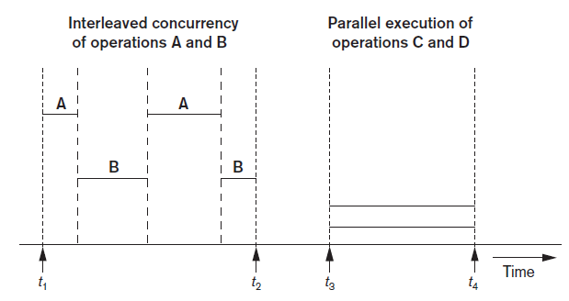
Buffering of Blocks
Buffering most useful when processes can run concurrently in parallel
Interleaved concurrency versus parallel execution

Slide 15
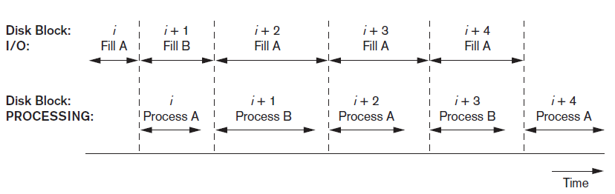
Buffering of Blocks (cont’d.)
Double buffering can be used to read continuous stream of blocks
Use of two buffers, A and B, for reading from disk

Slide 16











Multiple Buffer Pools
The DBMS does not always have a single buffer pool for the entire system.
→ Multiple buffer pool instances
→ Per-database buffer pool
→ Per-page type buffer pool
Helps reduce latch contention and improve locality.

Slide 17
Buffer replacement strategies
First-in-first-out (FIFO)
Least recently used (LRU)
Clock policy
Toss-immediate
Most recently used (MRU) strategy
Page Table
Frame1
Frame2
Frame3
Frame4
Frame5
Page 1
Page 1
Page 3
Page 3
Page 2
Page 1
Page 2
Page 3
Page 4
Page 5
…
Page 2
Page 4
Page 5
On- Disk File
Buffer Pool

Slide 18
Buffer replacement strategies
First-in-first-out (FIFO)
Least recently used (LRU)
Maintain a timestamp of when each page was last accessed.
When the DBMS needs to evict a page, select the one with the oldest timestamp.
→ Keep the pages in sorted order to reduce the search time on eviction.
Clock policy
Approximation of LRU that does not need a separate timestamp per page.
→ Each page has a reference bit.
→ When a page is accessed, set to 1.
Organize the pages in a circular buffer with a "clock hand":
→ Upon sweeping, check if a page's bit is set to 1.
→ If yes, set to zero. If no, then evict.

Slide 19
Buffer replacement strategies
Toss-immediate strategy
frees the space occupied by a block as soon as the final tuple of that block has been processed
Most recently used (MRU) strategy
system must pin the block currently being processed. After the final tuple of that block has been processed, the block is unpinned, and it becomes the most recently used block.

Slide 20
Example: Clock Policy
Single Clock Hand:
Advances only on page fault!
Check for pages not used recently
Page 1
Ref:
1
0
Page 8
Ref:
Page 2
Ref:
1
0
0
1
Access Page 1
Page 7
Ref:
Page 3
Ref:
0
0
1
Access Page 12
Page Fault!
Access Page 2
Page 12
Page 85
Page 4
Ref:
Page 6
Ref:
0
1
Access Page 12
0
Access Page 85
Page 5
Ref:
0
1
Page Fault!

Slide 21
Buffer-Replacement Policies
Limitations of LRU and CLOCK Replacement Policies
LRU and CLOCK are susceptible to sequential flooding
buffer pool’s contents are corrupted due to a sequential scan.
Sequential scans read every page
the timestamps of pages read may not reflect which pages we actually want.
the most recently used page is actually the most unneeded page.
Notes:
21

Slide 22
Buffer-Replacement Policies
How to address the limitations of LRU and CLOCK policies.
LRU-K which tracks the history of the last K references as timestamps and computes the interval between subsequent accesses. This history is used to predict the next time a page is going to be accessed.
Localization per query. The DBMS chooses which pages to evict on a per transaction/query basis. This minimizes the pollution of the buffer pool from each query.
Priority hints allow transactions to tell the buffer pool whether page is important or not based on the context of each page during query execution.
Notes:
22

Slide 23
Buffer-Replacement Policies
Buffer manager can use statistical information regarding the probability that a request will reference a particular relation
E.g., the data dictionary is frequently accessed. Heuristic: keep data-dictionary blocks in main memory buffer
Operating system or buffer manager may reorder writes
Can lead to corruption of data structures on disk
E.g., linked list of blocks with missing block on disk
File systems perform consistency check to detect such situations
Careful ordering of writes can avoid many such problems
Notes:
23

